Slide 1
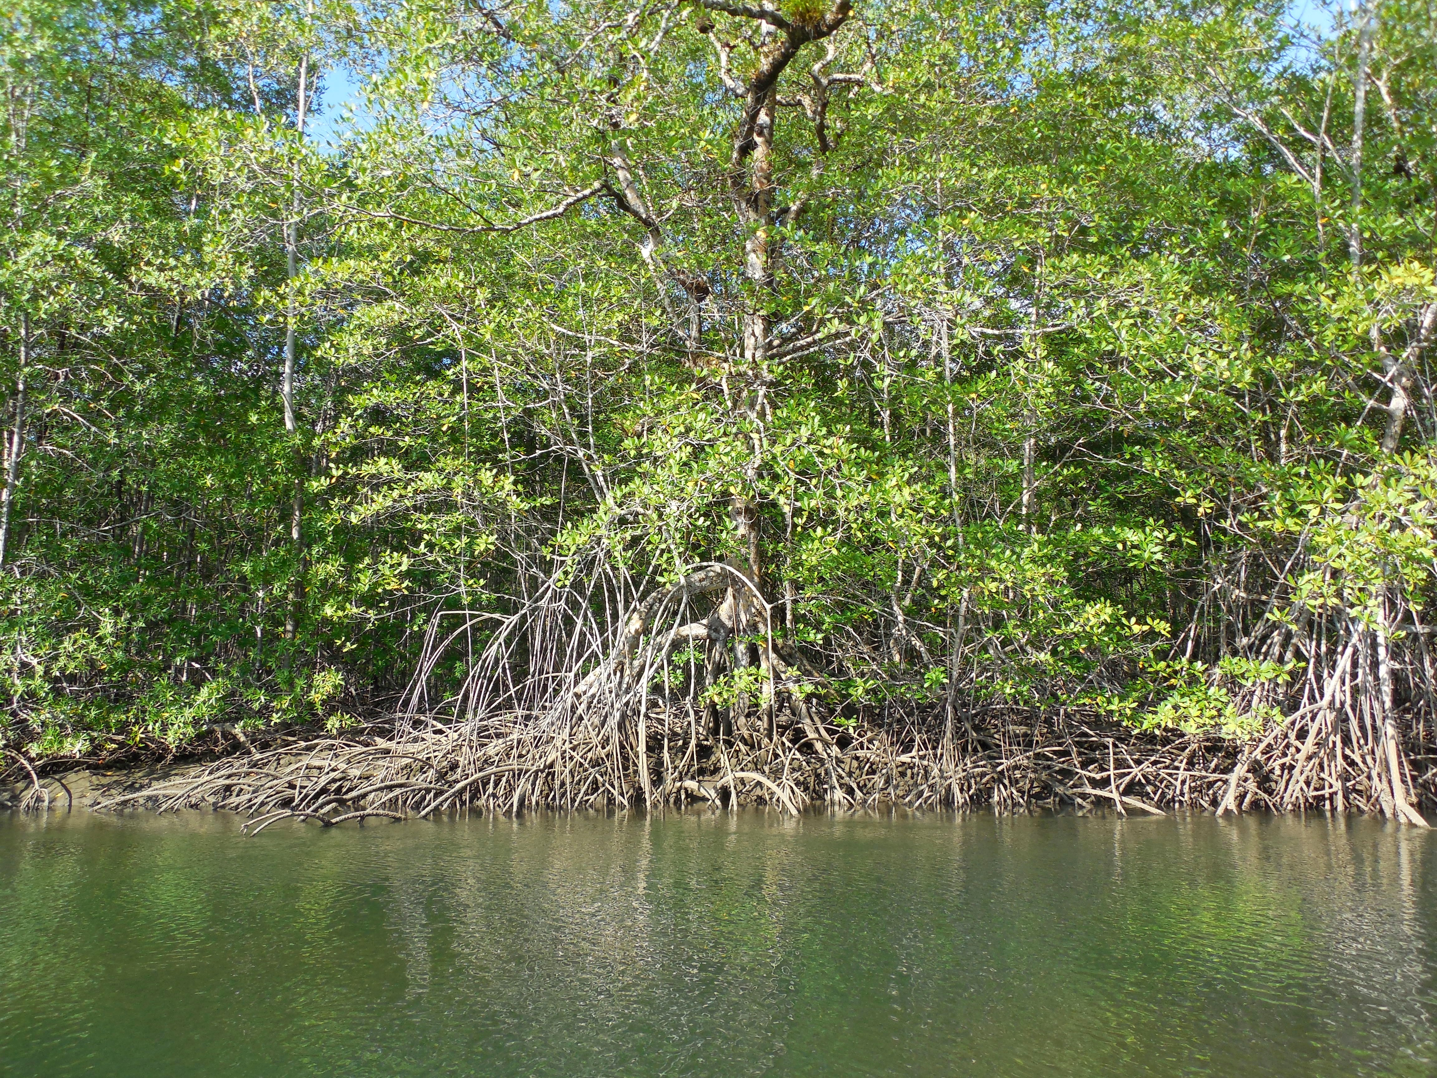
Total Carbon Estimation in African Mangroves and Coastal Wetlands in preparation for REDD and Blue Carbon Credits.
Lola Fatoyinbo¹, Carl Trettin², Marc Simard³, Matt Hansen⁴ , John Poulsen³, Seung Kuk Lee¹, David Lagomasino¹
NASA/GSFC
USFS
NASA/JPL
University of Maryland, College Park
Duke University

Slide 2
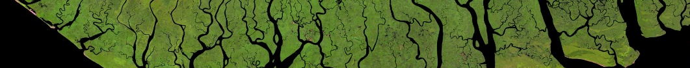


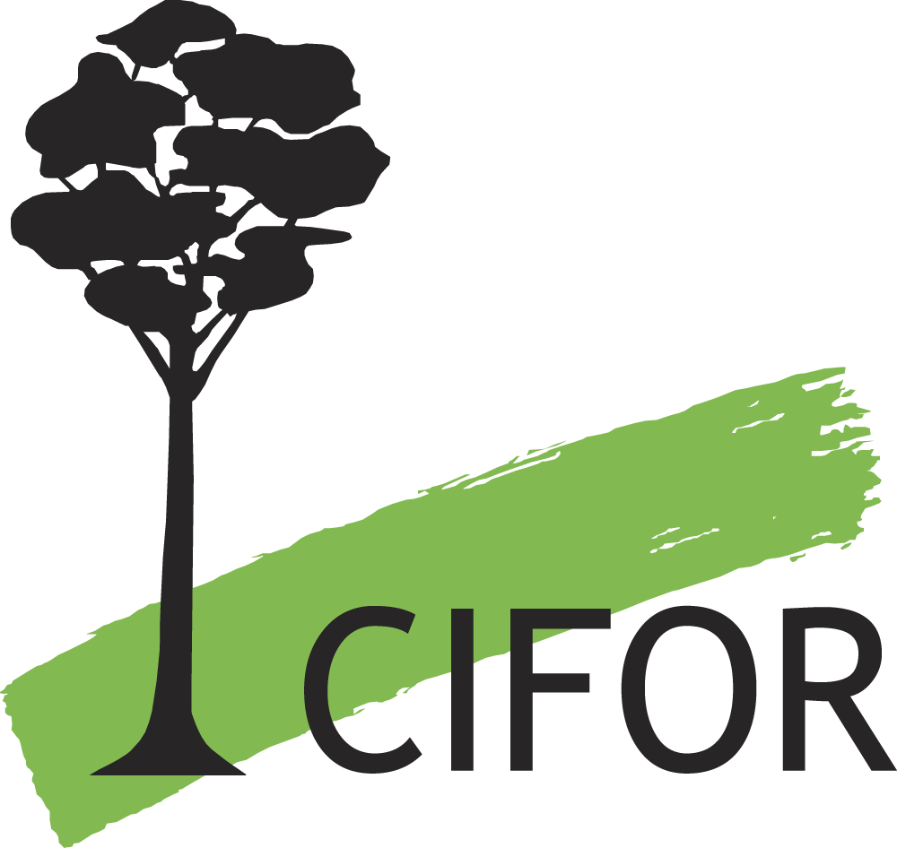
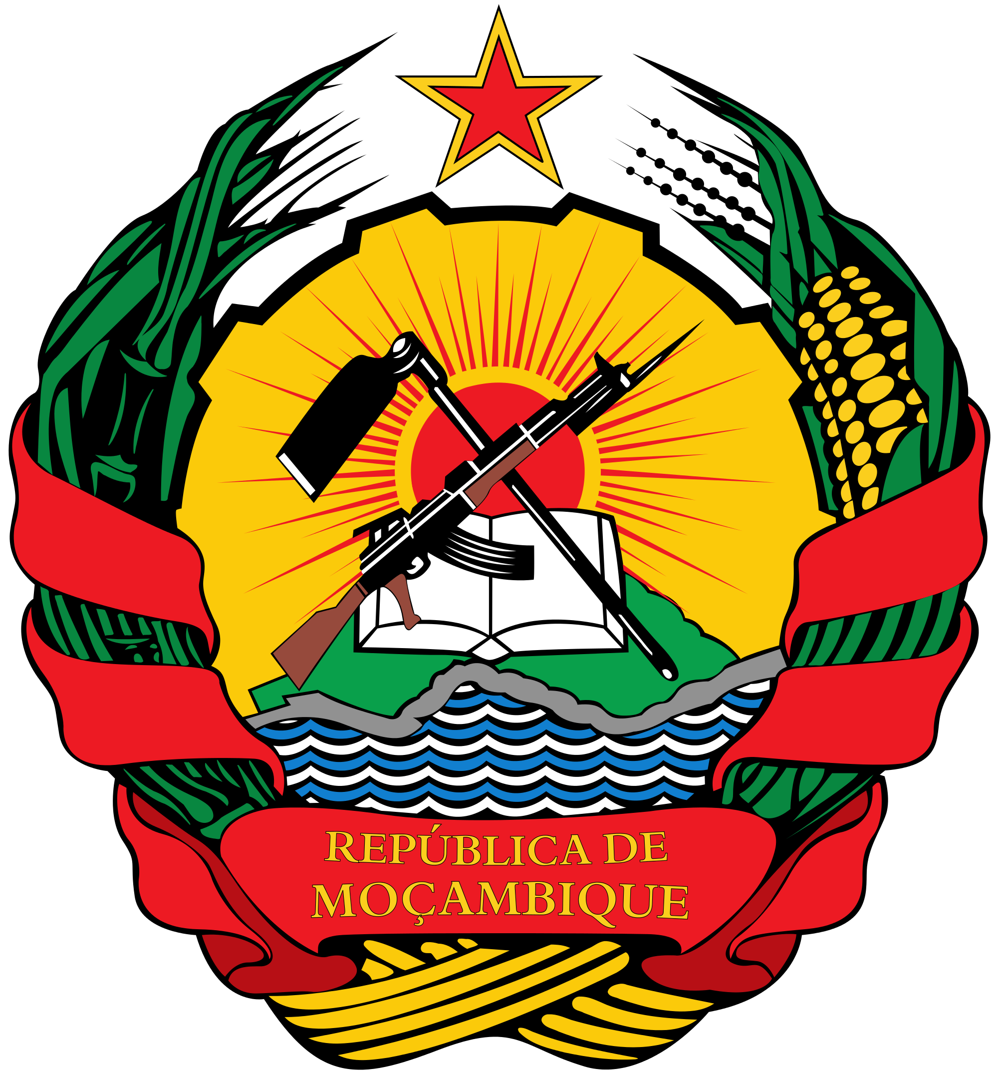
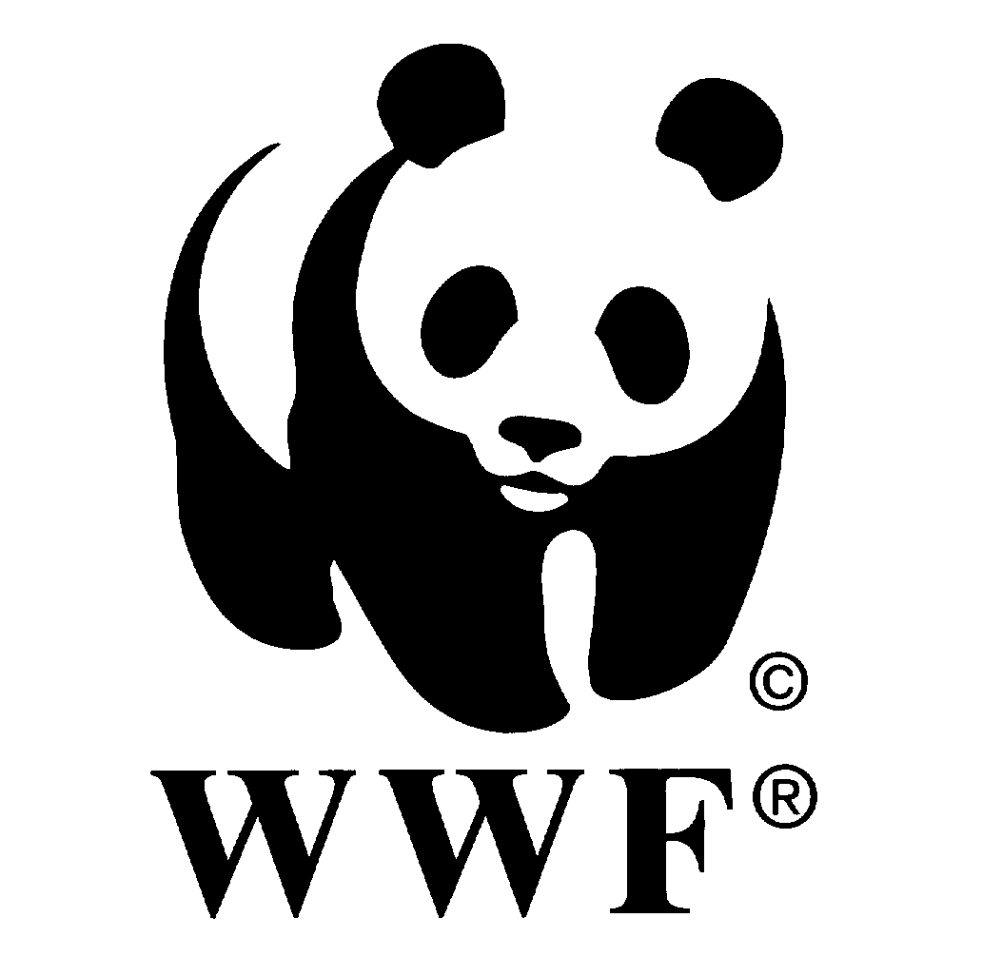

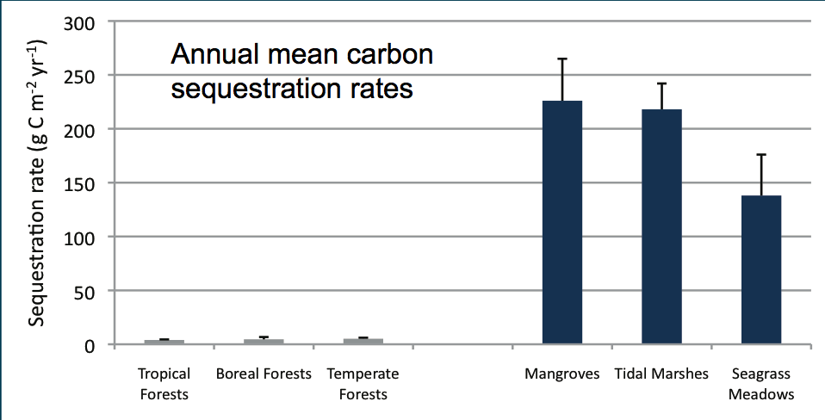



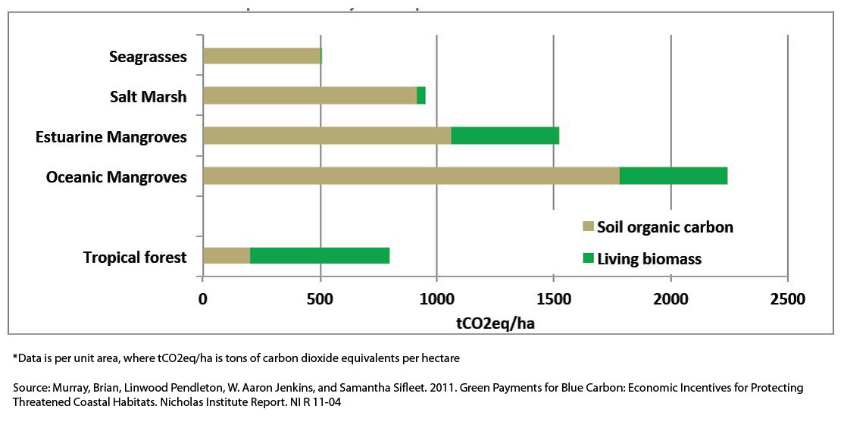


Blue carbon
is the carbon captured by the world's oceans and coastal ecosystems.
Donato et al, 2011
McLeod et al, 2011
Notes:
Mangroves and tidal wetlands have the highest carbon density among terrestrial ecosystems (Donato et al, 2011, Murray et al, 2011). Although they only represent 3 % of the total forest area (or 0.01 % of land area), C emissions from mangrove destruction alone at current rates could be equivalent to 10 % of carbon emissions from deforestation (Donato et al., 2011; Siikamaki et al, 2012). Due to their location along highly populated coastlines, they are under significant threat from anthropogenic activity as well as sea level rise (Alongi, 2002). In fact, it is estimated that over 50% of mangrove forests and tidal marshes have been destroyed over the past 60 years, with continued annual deforestation rates of 1% to 2% (Bouillon et al, 2008). The high C sequestration coupled with the high risk of destruction makes mangroves a prime candidate for carbon mitigation initiatives such as the United Nations Collaborative Programme on Reducing Emissions from Deforestation and Degradation in Deeveloping Countries (UNREDD and REDD+).

Slide 3
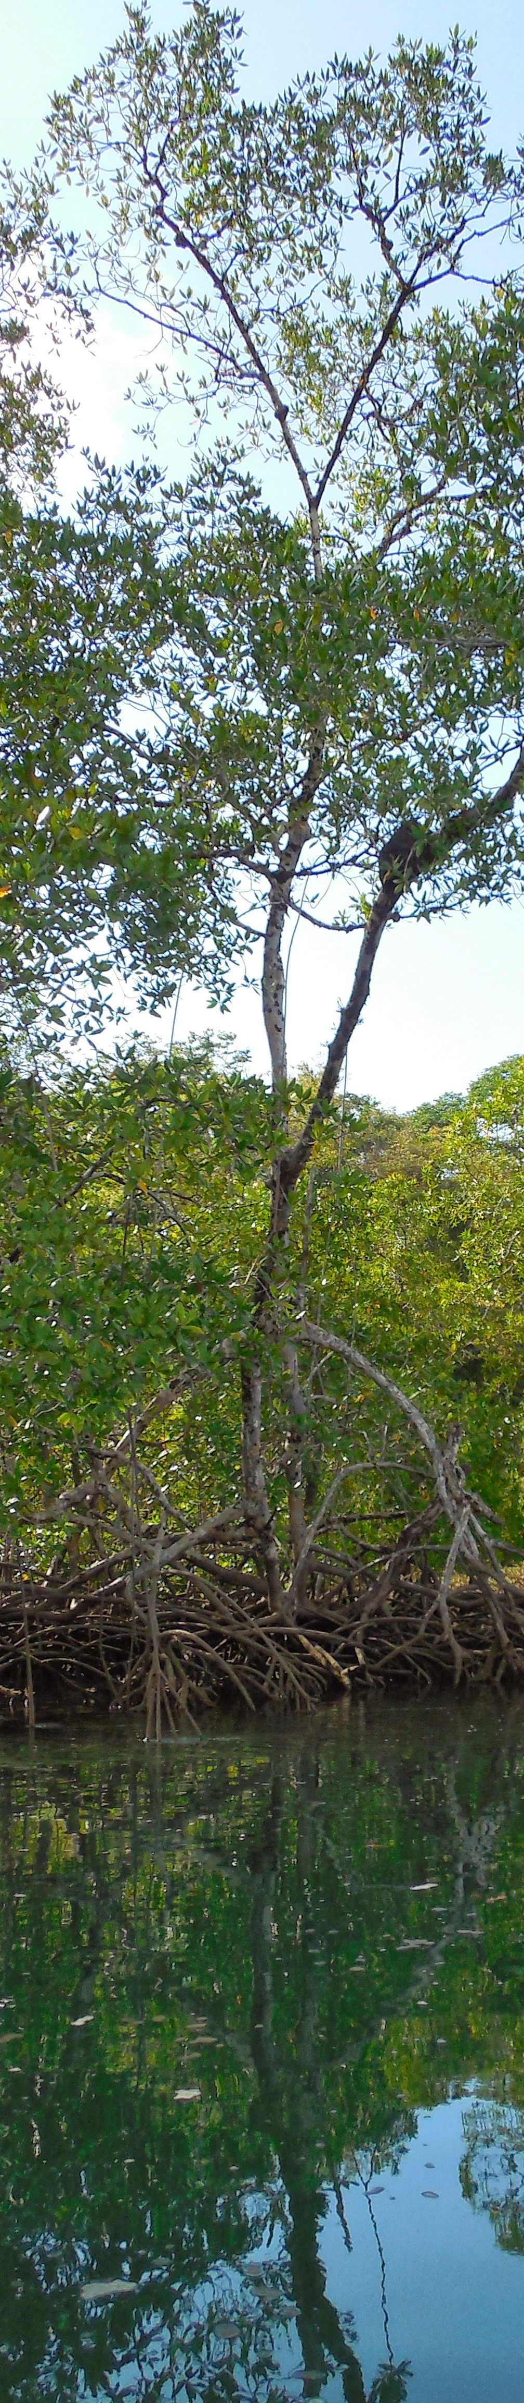
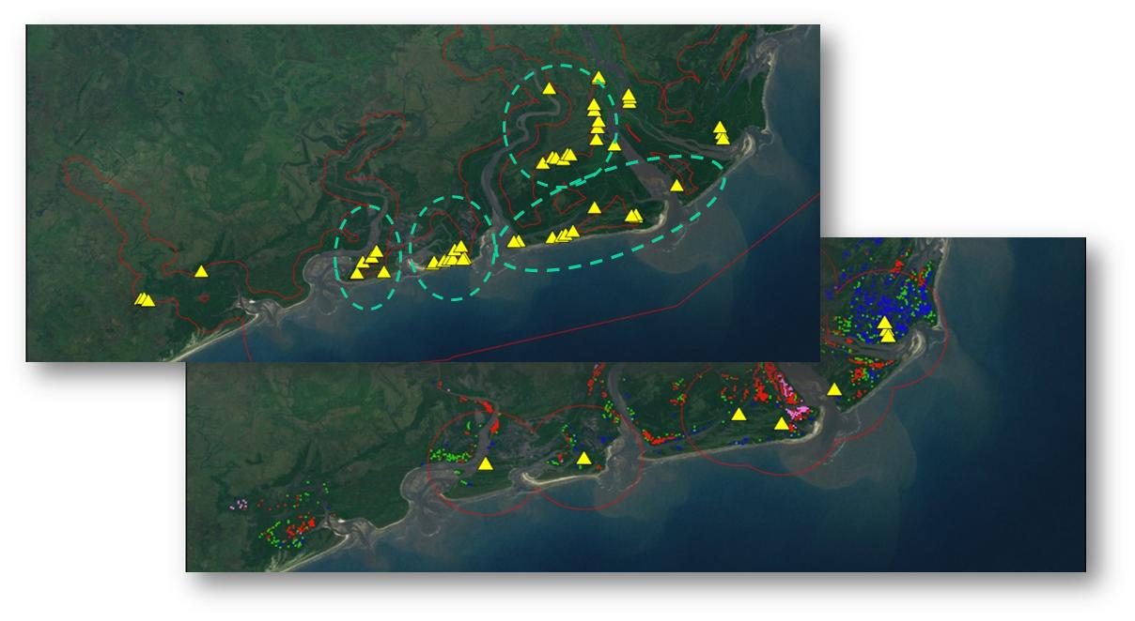
Objectives:
Develop the methodology and products for MRV-ready land cover, change and 3 dimensional height maps of mangroves and coastal wetlands using multi-sensor data (TanDEM-X, commercial Lidar, Landsat & VHR)
Measure above and belowground carbon stores in mangroves and adjoining land cover types based on the change and 3-D mapping stratification
Develop Carbon storage and emission estimates
Coordinate a Remote Sensing in Coastal ecosystems working group geared at local and international Remote Sensing and GIS specialists working in Coastal Ecosystems in Africa
Spatial optimization approaches to consider plot locations given the location of potential camp sites, strata type, location, travel distance, and other factors (e.g., fuel cost).

Slide 4
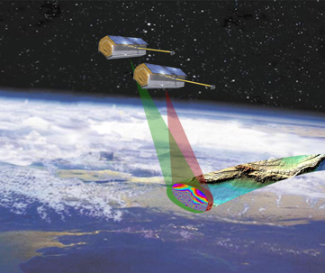
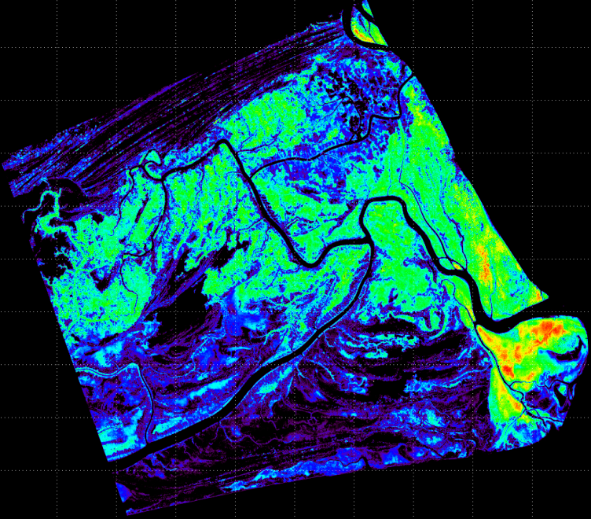
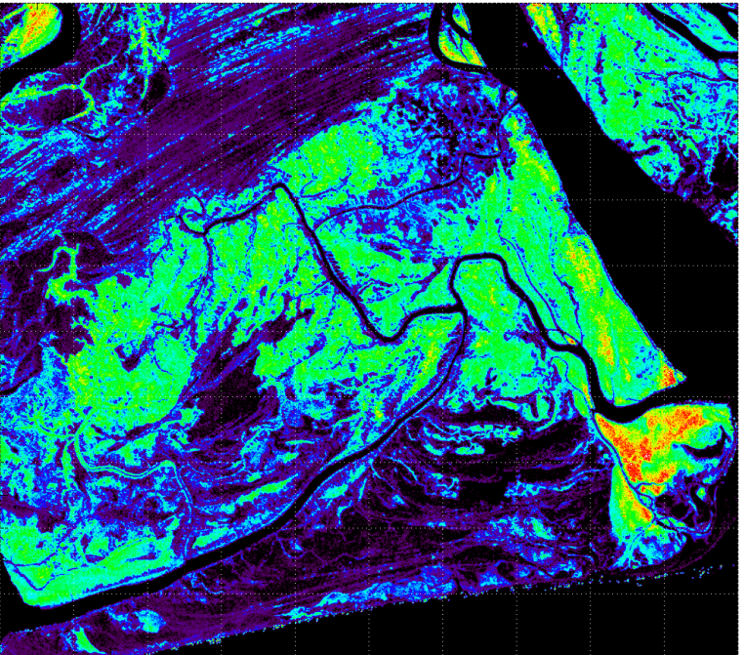
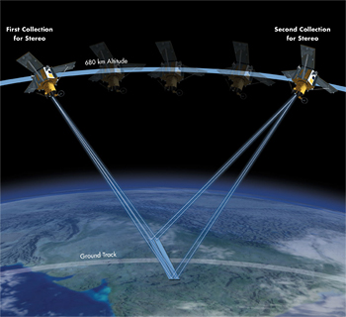
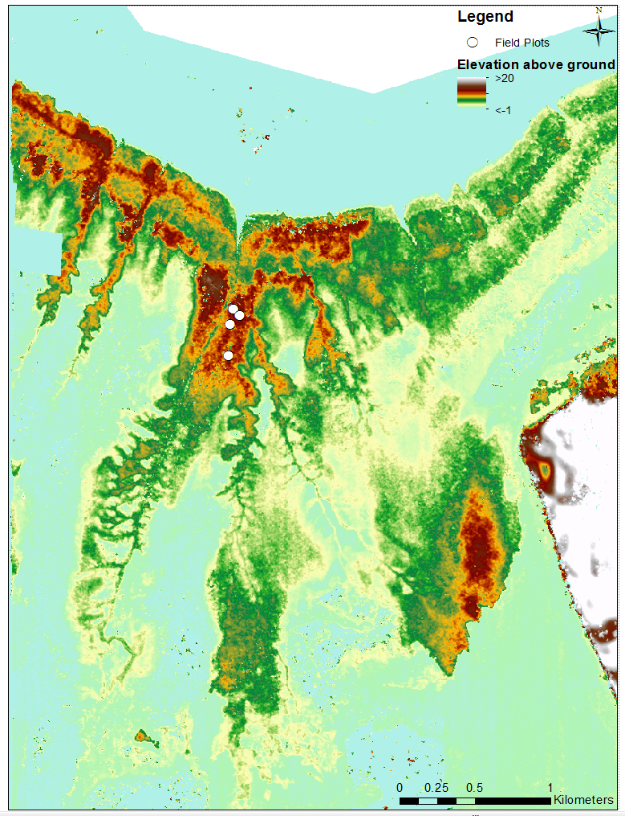
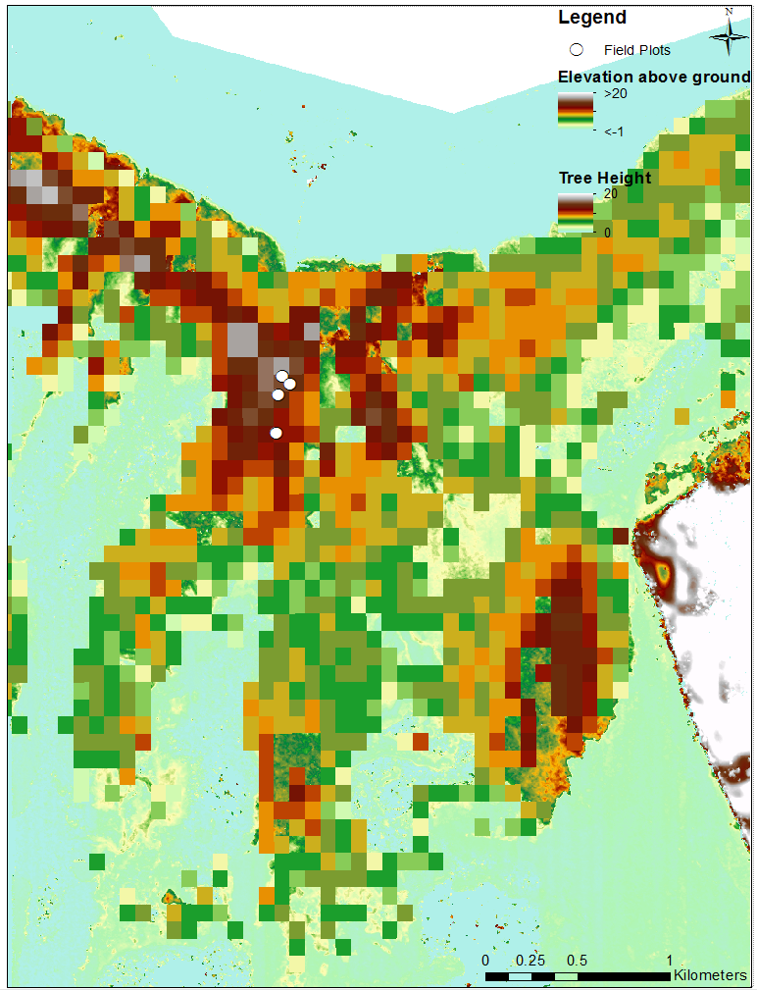
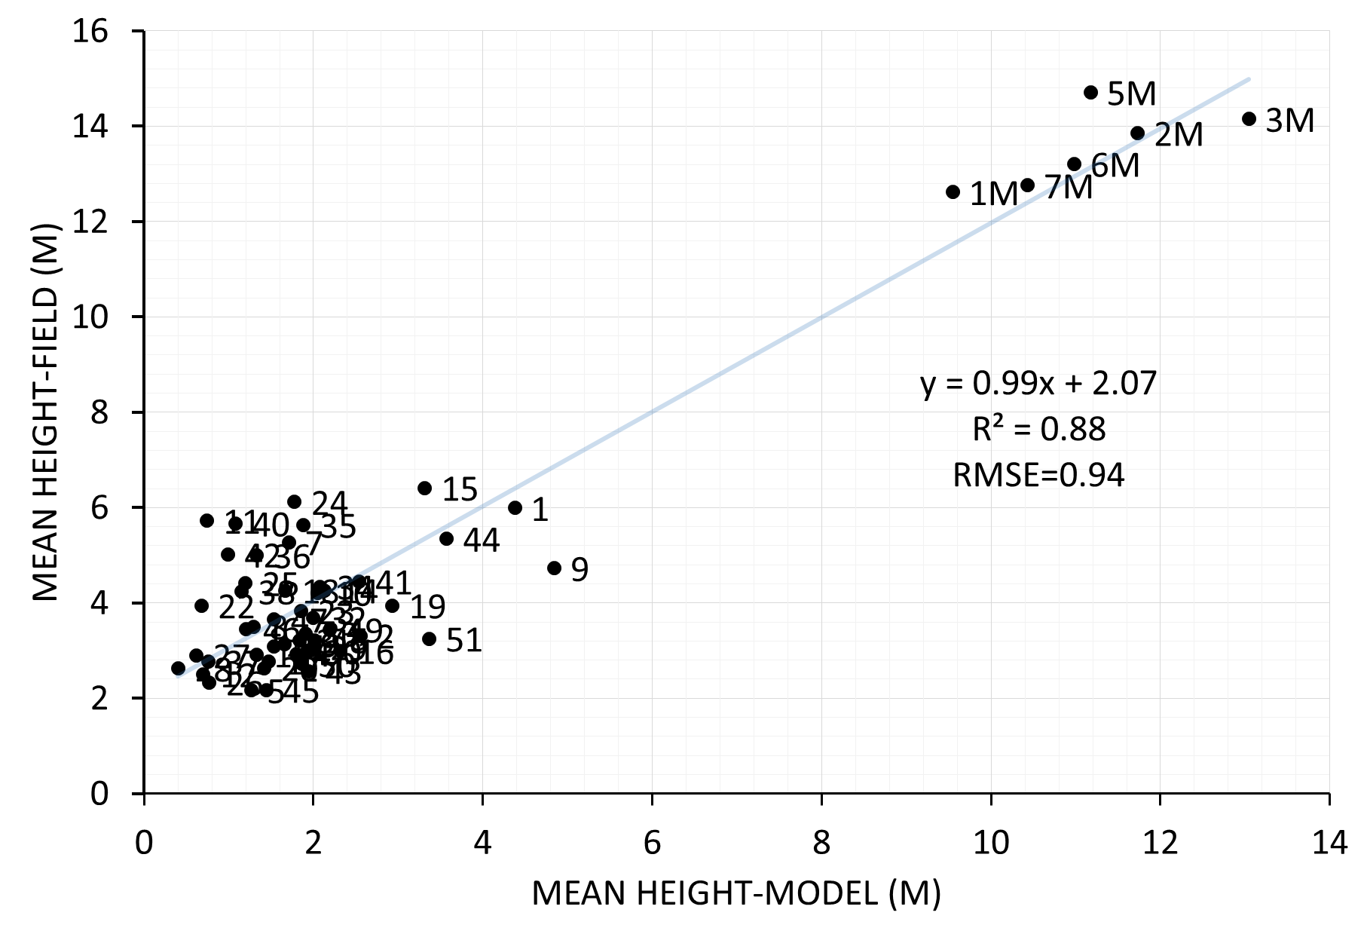
First Results
Lidar H100
TanDEM-X Canopy Height
World View Stereo canopy height
SRTM canopy height

